Slide 1

DriverPass System Analysis
Seth Richey
Notes:
[No speaker notes required for this slide.]

Slide 2

System Requirements
Students can register and schedule driving lessons
Admins can manage users and view logs
The system is safe and protects personal info
It works online and is available most of the time
Notes:
[In your speaker notes, include an explanation of the different requirements you determined for DriverPass’s system. What are the functional requirements you selected to describe? What are the nonfunctional requirements you selected to describe? Be sure to explain how these requirements meet DriverPass’s needs.]

Slide 3
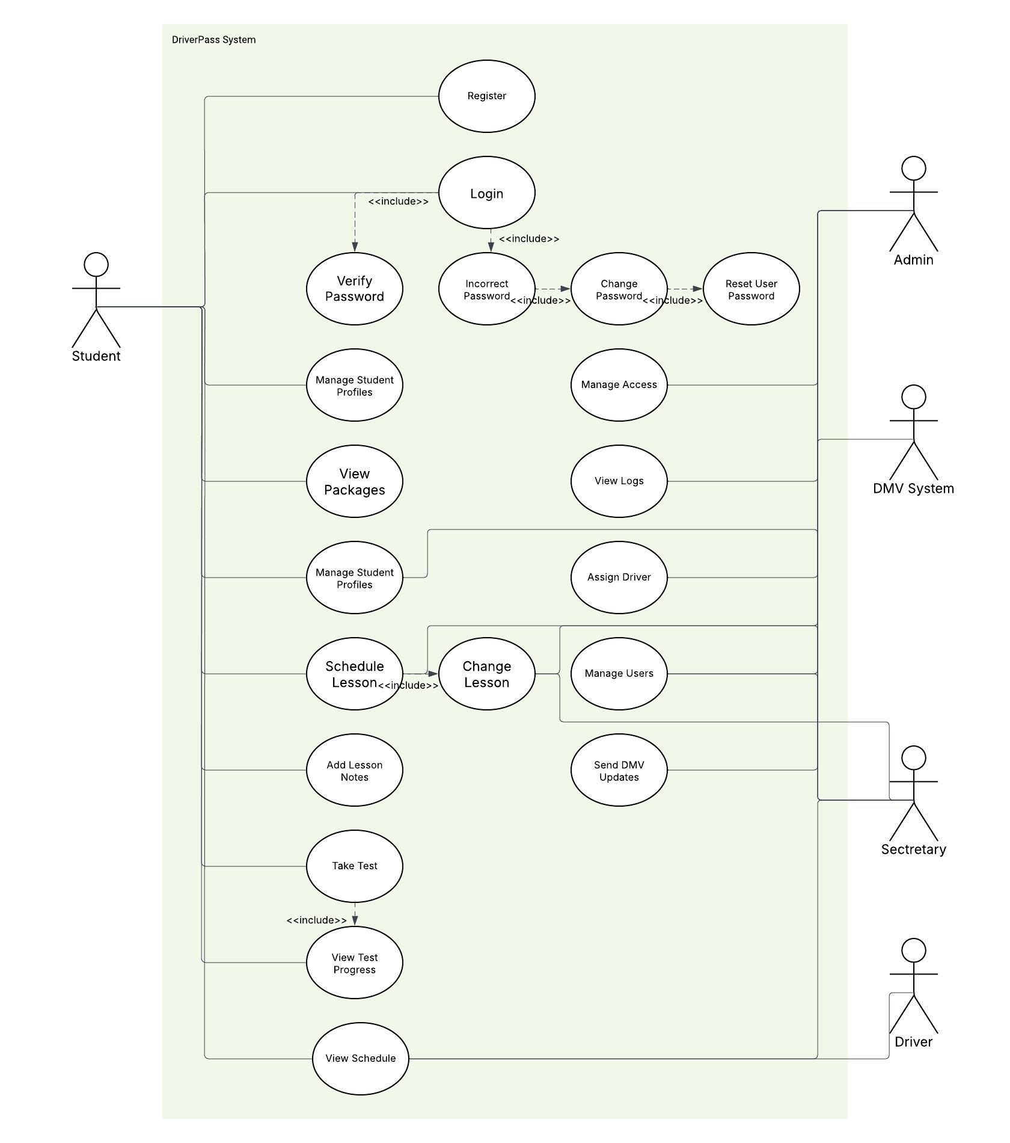
Use Case Diagram
[Insert your use case diagram here.]
Notes:
[Explain your diagram. Who are the different actors in the system? What are the different use cases? How did you account for DriverPass’s needs in your design? In your explanation, keep your audience in mind. Avoid the use of terms like “actors” and “use cases” in your explanation.]

Slide 4
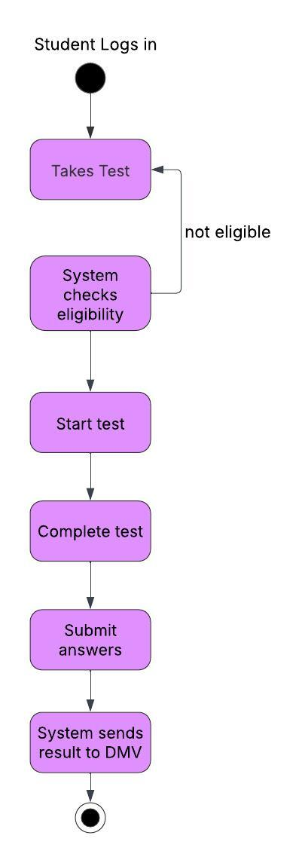
Activity Diagram
Notes:
[Explain your diagram. Which use case are you breaking down? What are the steps for this use case? How did you account for DriverPass’s needs in your design? In your explanation, keep your audience in mind. Avoid the use of technical terms such as “nodes,” “control flows,” and so on.]

Slide 5
Security
Safe login with password
Only certain people can see private info
Test data is protected
Info is backed up just in case
Notes:
[How did you consider security in your design? In your explanation, keep your audience in mind by avoiding the use of technical terms.]

Slide 6
System Limitations
No offline use
DMV info is limited
Students can’t message instructors yet
Lesson rescheduling depends on availability
Notes:
[What are the limitations of your design? In your explanation, keep your audience in mind by avoiding the use of technical terms.]

